Slide 1
liderança
17

Slide 2
Objetivos
Definir o que é um líder e o que é a liderança.
Comparar e contrastar as teorias iniciais sobre liderança.
Descrever as três principais teorias contingenciais sobre liderança.
Descrever perspetivas atuais sobre a liderança.
Discutir tópicos atuais que afetam a liderança.
17 - 2

Slide 3
Líderes e liderança
Líder
Alguém que consegue influenciar outras pessoas e que tem autoridade de gestão.
Liderança
O que os líderes fazem; processo de influenciar um grupo no sentido de atingir objetivos.
Idealmente, todos os gestores deviam ser líderes.
17 - 3
Notes:
Let’s begin by clarifying who leaders are and what leadership is. Our definition of a leader is someone who can influence others and who has managerial authority. Leadership is a process of leading a group and influencing that group to achieve its goals. It’s what leaders do. Are all managers leaders? Because leading is one of the four management functions, yes, ideally, all managers should be leaders. Thus, we’re going to study leaders and leadership from a managerial perspective.

Slide 4
Teorias iniciais sobre liderança
Teorias das características/traços pessoais (1920s -1930s)
  Pesquisa focalizada na identificação de características pessoais que diferenciam os líderes dos não-líderes.
  Ficou provado que é impossível identificar um conjunto de traços que diferenciaria sempre um líder de um não-líder.
17 - 4
Notes:
Leadership research in the 1920s and 1930s focused on isolating leader traits—that is, characteristics—that would differentiate leaders from nonleaders. Some of the traits studied included physical stature, appearance, social class, emotional stability, fluency of speech, and sociability. Despite the best efforts of researchers, it proved impossible to identify a set of traits that would always differentiate a leader (the person) from a nonleader.

Slide 5
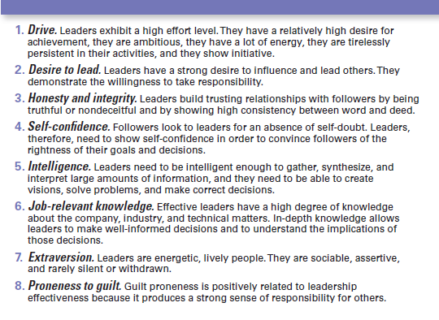
figura 17-1
Oito traços associados com a liderança
Notes:
The eight traits shown to be associated with effective leadership are described briefly in Exhibit 17-1.

Slide 6
Teorias iniciais sobre liderança (cont.)
Teorias comportamentais
Teorias que identificam comportamentos que diferenciam os líderes eficazes dos líderes não eficazes.
Estudos da Universidade de Iowa
Estudos da universidade de Ohio State
Estudos da Universidade de Michigan
Grelha de gestão de Blake e Mouton
17 - 6
Notes:
Researchers hoped that the behavioral theories approach would provide more definitive answers about the nature of leadership than did the trait theories.

Slide 7
Estudos da universidade de iowa
Estilo Autocrático – Líder que indica os métodos de trabalho, toma as decisões unilateralmente, e limita a participação dos empregados.
Estilo Democrático - Líder que envolve os subordinados na tomada de decisão, delega autoridade, e usa o feedback como uma oportunidade para orientar os empregados no seu desenvolvimento.
Estilo Laissez-faire – Líder que deixa os membros do grupo tomar decisões e realizar as tarefas como lhes parecer melhor.
17 - 7
Notes:
The University of Iowa studies explored three leadership styles to find which was the most effective.
The autocratic style described a leader who dictated work methods, made unilateral decisions, and limited employee participation. The democratic style described a leader who involved employees in decision-making, delegated authority, and used feedback as an opportunity for coaching employees. Finally, the laissez-faire style leader let the group make decisions and complete the work in whatever way it saw fit. The researchers’ results seemed to indicate that the democratic style contributed to both good quantity and quality of work.

Slide 8
Estudos da universidade de iowa (cont.)
Resultados da investigação:
Os resultados iniciais indicaram que o estilo democrático contribuía para uma boa quantidade e qualidade de trabalho.
Posteriormente, não foi possível confirmar estes resultados, de forma consistente. Finalmente, apenas em relação a uma maior satisfação no trabalho foi possível destacar um dos três estilos de liderança – i.e. o estilo democrático.
17 - 7
Notes:
The University of Iowa studies explored three leadership styles to find which was the most effective.
The autocratic style described a leader who dictated work methods, made unilateral decisions, and limited employee participation. The democratic style described a leader who involved employees in decision-making, delegated authority, and used feedback as an opportunity for coaching employees. Finally, the laissez-faire style leader let the group make decisions and complete the work in whatever way it saw fit. The researchers’ results seemed to indicate that the democratic style contributed to both good quantity and quality of work.

Slide 9
Estudos da universidade de Ohio State
  Identificaram duas dimensões do comportamento dos líderes.
    Iniciar estrutura: grau em que o líder define e estrutura o seu papel e o papel dos subordinados.
    Consideração: grau em que o líder procura ter relações de trabalho caracterizadas pela confiança mútua, respeito pelas ideias dos subordinados e atenção aos seus sentimentos.
17 - 8
Notes:
The Ohio State studies identified two important dimensions of leader behavior. The first was called initiating structure, which referred to the extent to which a leader defined his or her role and the roles of group members in attaining goals. It included behaviors that involved attempts to organize work, work relationships, and goals. The second was called consideration, which was defined as the extent to which a leader had work relationships characterized by mutual trust and respect for group members’ ideas and feelings. A leader who was high in consideration helped group members with personal problems, was friendly and approachable, and treated all group members as equals. He or she showed concern for (was considerate of) his or her followers’ comfort, well-being, status, and satisfaction.

Slide 10
Estudos da universidade de Ohio State (Cont.)
Resultados da investigação:
Os líderes com alta consideração e alta estrutura conseguem geralmente, mas não sempre, atingir os melhores resultados em termos de desempenho e satisfação.
Os resultados revelam que os fatores situacionais parecem influenciar fortemente a eficácia da liderança.
17 - 9
Notes:
Research found that a leader who was high in both initiating structure and consideration (a high–high leader) sometimes achieved high group task performance and high group member satisfaction, but not always.

Slide 11
Estudos da
Universidade de Michigan
Identificaram duas dimensões do comportamento dos líderes:
  Orientação para as pessoas: enfatizam as relações interpessoais.
  Orientação para a produção: enfatizam a realização de tarefas.
17 - 10
Notes:
Leadership studies conducted at the University of Michigan at about the same time as those done at Ohio State also hoped to identify behavioral characteristics of leaders that were related to performance effectiveness. The Michigan group also came up with two dimensions of leadership behavior, which they labeled employee oriented and production oriented.
Leaders who were employee oriented were described as emphasizing interpersonal relationships. The production-oriented leaders, in contrast, tended to emphasize the task aspects of the job. Unlike the other studies, the Michigan researchers concluded that leaders who were employee oriented were able to get high group productivity and high group member satisfaction.

Slide 12
Estudos da
Universidade de Michigan (Cont.)
Resultados da investigação:
  Os comportamentos orientados para as pessoas estão fortemente associados com alta produtividade do grupo e alta satisfação com o trabalho.
17 - 10
Notes:
Leadership studies conducted at the University of Michigan at about the same time as those done at Ohio State also hoped to identify behavioral characteristics of leaders that were related to performance effectiveness. The Michigan group also came up with two dimensions of leadership behavior, which they labeled employee oriented and production oriented.
Leaders who were employee oriented were described as emphasizing interpersonal relationships. The production-oriented leaders, in contrast, tended to emphasize the task aspects of the job. Unlike the other studies, the Michigan researchers concluded that leaders who were employee oriented were able to get high group productivity and high group member satisfaction.

Slide 13
Grelha de Gestão de blake e mouton
Grelha de gestão
Grelha de duas dimensões – i.e. a “preocupação com as pessoas” e a “preocupação com a produção” - para definir os estilos de liderança. Nesta podem destacar-se cinco estilos de liderança diferentes, nomeadamente:
  Gestão empobrecida
  Gestão de tarefa
  Gestão de compromisso
  Gestão social
  Gestão de equipa
17 - 11
Notes:
The behavioral dimensions from these early leadership studies provided the basis for the development of a two-dimensional grid for appraising leadership styles. This managerial grid used the behavioral dimensions “concern for people” (the vertical part of the grid) and “concern for production” (the horizontal part of the grid) and evaluated a leader’s use of these behaviors, ranking them on a scale from 1 (low) to 9 (high).
Although the grid had 81 potential categories into which a leader’s behavioral style might fall, only five styles were named: impoverished management (1,1 or low concern for production, low concern for people), task management (9,1 or high concern for production, low concern for people), middle-of-the-road management (5,5 or medium concern for production, medium concern for people), country club management (1,9 or low concern for production, high concern for people), and team management (9,9 or high concern for production, high concern
for people). Of these five styles, the researchers concluded that managers performed best when using a 9,9 style.

Slide 14
Grelha de gestão
1,9
Estilo Social
9,9
Estilo Gestão Equipa
(Alta)
9
8
7
6
5
4
3
2
1
Pessoas
5,5
Estilo
Compromisso
(Baixa)
9,1
Estilo Tarefa
1,1
Estilo
Empobrecido
1 2 3 4 5 6 7 8 9
(Baixa)
Tarefa
(Alta)

Slide 15
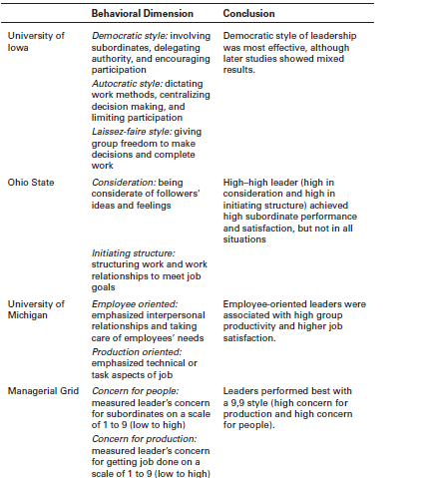
Figura 17-2 teorias comportamentais
17 - 12
Notes:
The four main leader behavior studies are summarized in Exhibit 17-2.

Slide 16
Teorias contingenciais da liderança
Modelo contingencial de Fiedler
Teoria da liderança situacional de Hersey e Blanchard
Teoria da meta-caminho (path-goal model)
17 - 13
Notes:
The first comprehensive contingency model for leadership was developed by Fred Fiedler. The Fiedler contingency model proposed that effective group performance depended on properly matching the leader’s style and the amount of control and influence in the situation. The model was based on the premise that a certain leadership style would be most effective in different types of situations. The keys were to (1) define those leadership styles and the different types of situations, and then (2) identify the appropriate combinations of style and situation.

Slide 17
Teorias contingenciais da liderança
Modelo contingencial de Fiedler
Teoria de liderança que propõe que o desempenho do grupo depende do alinhamento do estilo do líder com a situação em causa.
17 - 13
Notes:
The first comprehensive contingency model for leadership was developed by Fred Fiedler. The Fiedler contingency model proposed that effective group performance depended on properly matching the leader’s style and the amount of control and influence in the situation. The model was based on the premise that a certain leadership style would be most effective in different types of situations. The keys were to (1) define those leadership styles and the different types of situations, and then (2) identify the appropriate combinations of style and situation.

Slide 18
Modelo de Fiedler (cont.)
Least-preferred coworker (LPC) questionnaire - Questionário sobre o colega de que menos se gosta
Questionário que mede se o líder é orientado para a tarefa ou para as pessoas.
17 - 14
Notes:
Fiedler proposed that a key factor in leadership success was an individual’s basic leadership style, either task oriented or relationship oriented. To measure a leader’s style, Fiedler developed the least-preferred coworker (LPC) questionnaire. This questionnaire contained 18 pairs of contrasting adjectives—for example, pleasant–unpleasant, cold–warm, boring–interesting, or friendly–unfriendly. Respondents were asked to think of all the coworkers they had ever had and to describe that one person they least enjoyed working with by rating him or her on a scale of 1 to 8 for each of the 18 sets of adjectives (the 8 always described the positive adjective out of the pair and the 1 always described the negative adjective out of the pair).

Slide 19
Modelo de Fiedler (cont.)
Dimensões/fatores contingênciais:
Relação entre o líder e os membros do grupo: grau de confiança e respeito que os empregados têm pelo líder.
Estruturação da tarefa: grau em que as tarefas estão formalizadas e estruturadas.
Posição de poder: grau de influência que o líder tem sobre atividades como a admissão, despedimento, ações de disciplina, promoções e aumentos salariais.
17 - 15
Notes:
After an individual’s leadership style had been assessed through the LPC, it was time to evaluate the situation in order to be able to match the leader with the situation. Fiedler’s research uncovered three contingency dimensions that defined the key situational factors in leader effectiveness.
• Leader-member relations – the degree of confidence, trust, and respect employees had for their leader; rated as either good or poor.
• Task structure – the degree to which job assignments were formalized and structured; rated as either high or low.
• Position power – the degree of influence a leader had over activities such as hiring, firing, discipline, promotions, and salary increases; rated as either strong or weak.

Slide 20
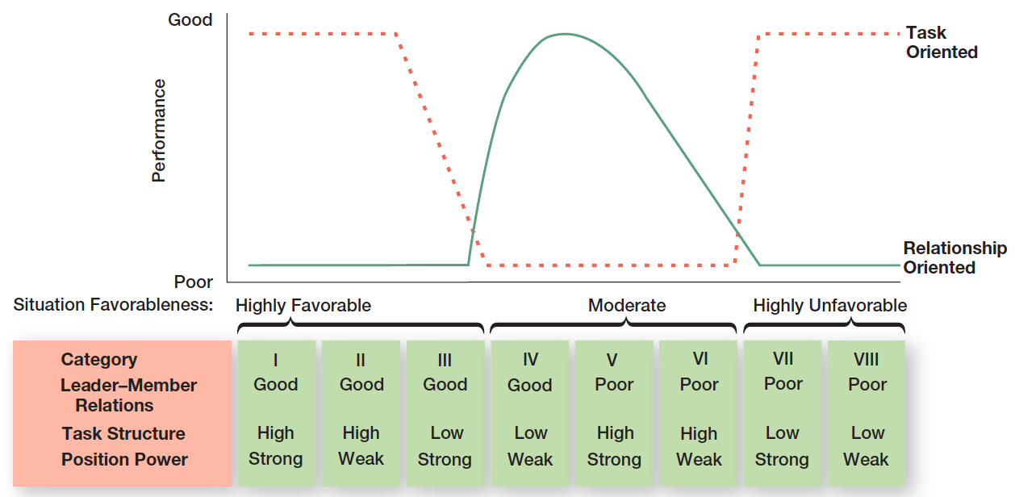
figura 17-3 modelo de Fiedler
17 - 16
Notes:
Each leadership situation was evaluated in terms of these three contingency variables, which, when combined, produced eight possible situations that were either favorable or unfavorable for the leader. (See the bottom of the chart in Exhibit 17-3.) Situations I, II, and III were classified as highly favorable for the leader. Situations IV, V, and VI were moderately favorable for the leader. And situations VII and VIII were described as highly unfavorable for the leader.

Slide 21
Teoria da liderança situacional Hersey and Blanchard
Situational leadership theory (SLT)
Teoria contingencial que se focaliza na maturidade dos subordinados.
Maturidade (Readiness): grau em que os subordinados têm capacidade (“sabem”) e motivação (“querem”) para realizar uma tarefa.
17 - 17
Notes:
Paul Hersey and Ken Blanchard developed a leadership theory that has gained a strong following among management development specialists. This model, called situational leadership theory (SLT), is a contingency theory that focuses on followers’ readiness.
Regardless of what the leader does, the group’s effectiveness depends on the actions of the followers. This important dimension
has been overlooked or underemphasized in most leadership theories. And readiness, as defined by Hersey and Blanchard, refers to the extent to which people have the ability and willingness to accomplish a specific task.

Slide 22
Teoria da liderança situacional Hersey and Blanchard
High
Participating
Selling
S3
S2
Relationship behavior
(amount of support required)
S4
S1
Delegating
Telling
Low
Low
High
Task behaviors
(direct behavior)
R4
R3
R2
R1
+
-
Maturity of Subordinates

Slide 23
Estilos de liderança na slt
Hersey and Blanchard
Telling (Diretivo): O líder define as funções e diz às pessoas o que devem fazer, quando, como e onde.
Selling (Apoiante): O líder tem um comportamento simultaneamente diretivo e de apoio.
Participating (Participação): O líder envolve os seguidores na tomada de decisão, fazendo uso das suas capacidades e motivando-os.
Delegating (Delegação): O líder não dá nem direção, nem apoio.
17 - 18
Notes:
SLT uses the same two leadership dimensions that Fiedler identified: task and relationship behaviors. However, Hersey and Blanchard go a step further by considering each as either high or low and then combining them into four specific leadership styles described as follows:
• Telling (high task–low relationship): The leader defines roles and tells people what, how, when, and where to do various tasks.
• Selling (high task–high relationship): The leader provides both directive and supportive behavior.

Slide 24
Níveis de maturidade dos subordinados na slt
Hersey and Blanchard
R1: Pessoas que não têm competências, nem motivação (não sabem, nem querem).
R2: Pessoas que não têm competência, mas têm motivação (não sabem, mas querem).
R3: Pessoas que têm competência, mas não têm motivação (sabem, mas não querem) .
R4: Pessoas que têm competência e motivação (sabem e querem).
17 - 20
Notes:
The final component in the model is the four stages of follower readiness:
R1: People are both unable and unwilling to take responsibility for doing something. Followers aren’t competent or confident.
R2: People are unable but willing to do the necessary job tasks. Followers are motivated but lack the appropriate skills.

Slide 25
path-goal Model (meta-caminho )
Path-goal theory
Teoria de liderança que afirma que a função do líder é ajudar os seguidores a atingir os seus objetivos e fornecer direção e apoio, para assegurar que esses objetivos são compatíveis com os do grupo ou da organização.
17 - 22
Notes:
Another approach to understanding leadership is path-goal theory, which states that the leader’s job is to assist followers in attaining their goals and to provide direction or support needed to ensure that their goals are compatible with the goals of the group or organization. Developed by Robert House, path-goal theory takes key elements from the expectancy theory of motivation. The term path-goal is derived from the belief that effective leaders remove the roadblocks and pitfalls so that followers have a clearer path to help them get from where they are to the achievement of their work goals.

Slide 26
Path-Goal Model (cont.)
Quatro comportamentos de liderança:
  Liderança diretiva: Comunica aos subordinados o que devem fazer e como devem atuar, planeia e coordena o trabalho, controla o cumprimento de regras e procedimentos, estabelece padrões de desempenho.
  Liderança apoiante: Mostra respeito e consideração pelo bem-estar e necessidades dos colaboradores, atua cortesmente e cria um ambiente social amistoso.
17 - 23
Notes:
House identified four leadership behaviors:
Directive leader: Lets subordinates know what’s expected of them, schedules work to be done, and gives specific guidance on how to accomplish tasks.
Supportive leader: Shows concern for the needs of followers and is friendly.

Slide 27
Path-Goal Model (cont.)
Quatro comportamentos de liderança: (cont.)
  Liderança participativa: Consulta os trabalhadores, solicita-lhes sugestões, e toma as respetivas ideias em conta, quando toma decisões.
  Liderança orientada para o êxito: Estabelece metas desafiadoras para os colaboradores, enfatiza a excelência, e transmite aos colaboradores a expectativa de que eles alcançarão elevados desempenhos.
17 - 24
Notes:
Participative leader: Consults with group members and uses their suggestions before making a decision.
Achievement oriented leader: Sets challenging goals and expects followers to perform at their highest level.
In contrast to Fiedler’s view that a leader couldn’t change his or her behavior, House assumed that leaders are flexible and can display any or all of these leadership styles depending on the situation.

Slide 28
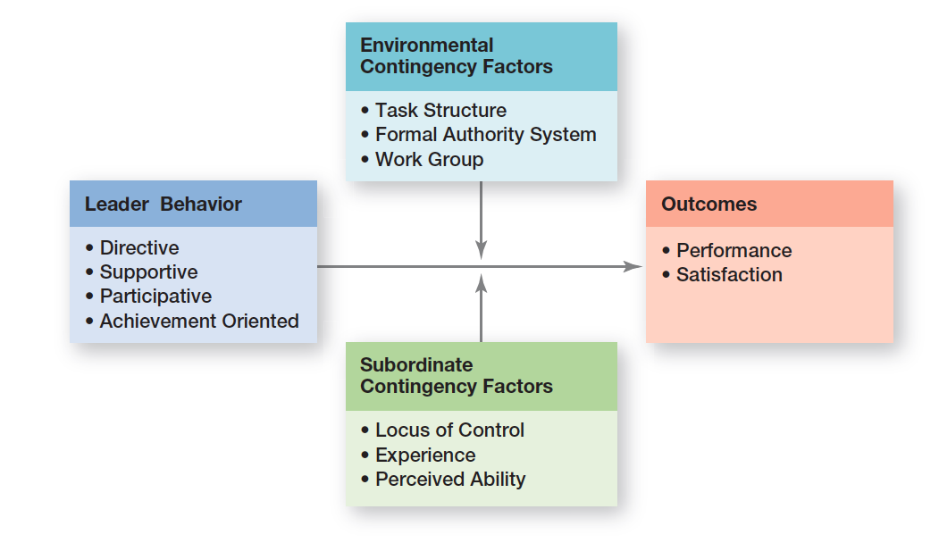
figura 17-4
Path-Goal Model
17 - 25
Notes:
As Exhibit 17-4 illustrates, path-goal theory proposes two situational or contingency variables that moderate the leadership behavior–outcome relationship: those in the environment that are outside the control of the follower (factors including task structure, formal authority system, and the work group) and those that are part of the personal characteristics of the follower (including locus of control, experience, and perceived ability).

Slide 29
Perspetivas contemporâneas sobre a motivação
Leader–member exchange theory (LMX) - Modelo das trocas entre líder e liderados
Teoria que argumenta que os líderes criam “in-groups" e “out-groups” e que os liderados que fazem parte do “in-group" são aqueles em que o líder confia, recebem mais tempo de atenção, mais privilégios e melhores avaliações de desempenho.
Em consequência, apresentam um menor turnover (rotatividade) e estão mais satisfeitos.
17 - 26
Notes:
Leader–member exchange theory (LMX) says leaders create in-groups and out-groups and those in the in-group will have higher performance ratings, less turnover, and greater job satisfaction. LMX theory suggests that early on in the relationship between a leader and a given follower, a leader will implicitly categorize a follower as an “in” or as an “out.” That relationship tends to remain fairly stable over time. Leaders also encourage LMX by rewarding those employees with whom they want a closer linkage and punishing those with whom they do not.

Slide 30
Perspetivas contemporâneas sobre a motivação (cont.)
Liderança transacional – líderes que utilizam sobretudo as trocas sociais para obterem resultados dos seus subordinados.
Liderança transformacional - líderes que estimulam e inspiram os seguidores a atingirem resultados extraordinários.
17 - 27
Notes:
Many early leadership theories viewed leaders as transactional leaders; that is, leaders who lead primarily by using social exchanges (or transactions). Transactional leaders guide or motivate followers to work toward established goals by exchanging rewards for their productivity. But another type of leader—a transformational leader—stimulates and inspires (transforms) followers to achieve extraordinary outcomes.

Slide 31
Perspetivas contemporâneas sobre a motivação (cont.)
Transactional
Leadership
Motivating for
performance at
expected levels.
Initiating
structure to
clarify roles
and tasks.
Stressing the
link between
reward and
goal achievement.
Transformational Leadership
Motivating for performance
beyond expectations
Inspiring for missions
beyond self interest
Instilling confidence to
achieve superior performance

Slide 32
Perspetivas contemporâneas sobre a motivação (cont.)
Líder carismático - líder entusiasta e autoconfiante, cuja personalidade e ações influenciam as pessoas a agirem de determinada maneira.
Liderança visionária – capacidade de criar e articular uma visão de futuro realista, credível e atrativa, no sentido de melhorar a situação atual.
17 - 28
Notes:
A charismatic leader is an enthusiastic, self-confident leader whose personality and actions influence people to behave in certain ways. Several authors have attempted to identify personal characteristics of the charismatic leader. The most comprehensive analysis identified five such characteristics: they have a vision, the ability to articulate that vision, a willingness to take risks to achieve that vision, a sensitivity to both environmental constraints and follower needs, and behaviors that are out of the ordinary.
Although the term vision is often linked with charismatic leadership, visionary leadership is different; it’s the ability to create and articulate a realistic, credible, and attractive vision of the future that improves on the present situation. This vision, if properly selected and implemented, is so energizing that it “in effect jump-starts the future by calling forth the skills, talents, and resources to make it happen.”

Slide 33
Perspetivas contemporâneas sobre a motivação (cont.)
Liderança de equipas
Muitos líderes não conseguem dar resposta às necessidades atuais, de liderar em contexto de equipa.
A função de um líder de equipa tem duas prioridades:
  Gerir as fronteiras externas da equipa.
  Facilitar os processos da equipa.
17 - 29
Notes:
Because leadership is increasingly taking place within a team context and more organizations are using work teams, the role of the leader in guiding team members has become increasingly important. The role of team leader is different from the traditional leadership role.
Many leaders are not equipped to handle the change to employee teams. As one consultant noted, “Even the most capable managers have trouble making the transition because all the command-and-control type things they were encouraged to do before are no longer appropriate.”
One study looking at organizations that reorganized themselves around employee teams found certain common responsibilities of all leaders. These leader responsibilities included coaching, facilitating, handling disciplinary problems, reviewing team and individual performance, training, and communication. However, a more meaningful way to describe the team leader’s job is to focus on two priorities: (1) managing
the team’s external boundary, and (2) facilitating the team process. These priorities entail four specific leadership roles, which are identified in Exhibit 17-5.

Slide 34
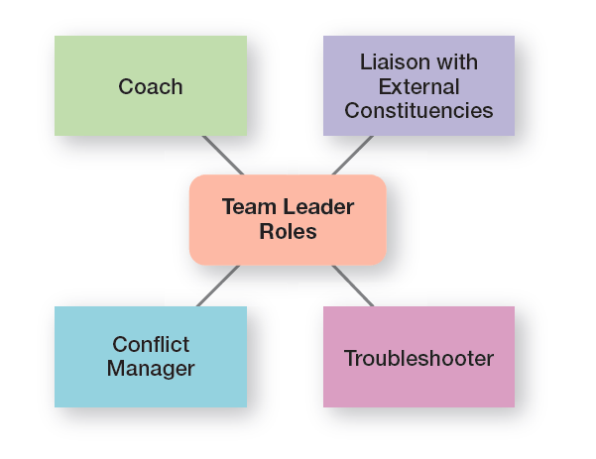
figura 17-5 papéis dos líderes de equipas
17 - 30

Slide 35
Tópicos de liderança no século XXI
Gestão do poder
  Poder legítimo - derivado da posição na hierarquia e do reconhecimento dessa autoridade por outros.
  Poder coercivo - derivado da possibilidade de impor punições e de controlar outros.
  Poder de recompensa - derivado da possibilidade de distribuir recompensas e benefícios valorizados por outros.
  Poder de informação – derivado da possibilidade de controlar informação importante para outros
17 - 31
Notes:
Where do leaders get their power—that is, their right and capacity to influence work actions or decisions? Five sources of leader power have been identified: legitimate, coercive, reward, expert, and referent.
Legitimate power and authority are the same. Legitimate power represents the power a leader has as a result of his or her position in the organization. Although people in positions of authority are also likely to have reward and coercive power, legitimate power is broader than the power to coerce and reward.
Coercive power is the power a leader has to punish or control. Followers react to this power out of fear of the negative results that might occur if they don’t comply. Managers typically have some coercive power, such as being able to suspend or demote employees or to assign them work they find unpleasant or undesirable.
Reward power is the power to give positive rewards. A reward can be anything a person values such as money, favorable performance appraisals, promotions, interesting work assignments, friendly colleagues, and preferred work shifts or sales territories.

Slide 36
Tópicos de liderança no século XXI
Gestão do Poder (cont.)
  Poder técnico - derivado de conhecimentos e competências superiores aos outros, numa determinada área.
  Poder de referência - derivado da admiração e respeito de outros, em virtude das suas características e traços pessoais.
17 - 32
Notes:
Expert power is power based on expertise, special skills, or knowledge. If an employee has skills, knowledge, or expertise that’s critical to a work group, that person’s expert power is enhanced.
Finally, referent power is the power that arises because of a person’s desirable resources or personal traits. If I admire you and want to be associated with you, you can exercise power over me because I want to please you. Referent power develops out of admiration of another and a desire to be like that person.

Slide 37
Tópicos de liderança
no século XXI
Desenvolver a Confiança
  Credibilidade – grau em que os seguidores veem o líder como honesto, competente e capaz de inspirar.
  Confiança – crença na integridade, carácter e capacidade de um líder.
17 - 33
Notes:
“Honesty is absolutely essential to leadership. If people are going to follow someone willingly, whether it be into battle or into the boardroom, they first want to assure themselves that the person is worthy of their trust.” In addition to being honest, credible leaders are competent and inspiring. They are personally able to effectively communicate their confidence and enthusiasm. Thus, followers judge a leader’s credibility in terms of his or her honesty, competence, and ability to inspire.
Trust is closely entwined with the concept of credibility, and, in fact, the terms are often used interchangeably. Trust is defined as the belief in the integrity, character, and ability of a leader. Followers who trust a leader are willing to be vulnerable to the leader’s actions because they are confident that their rights and interests will not be abused.

Slide 38
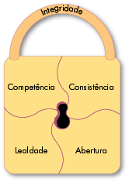
Tópicos de liderança
no século XXI
Cinco dimensões da
confiança
17 - 34
Notes:
Research has identified five dimensions that make up the concept of trust:
• Integrity: honesty and truthfulness
• Competence: technical and interpersonal knowledge and skills
• Consistency: reliability, predictability, and good judgment in handling situations
• Loyalty: willingness to protect a person, physically and emotionally
• Openness: willingness to share ideas and information freely
Of these five dimensions, integrity seems to be the most critical when someone assesses another’s trustworthiness.

Slide 39
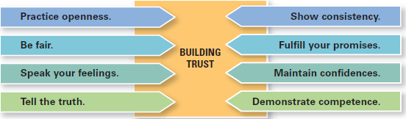
figura 17-6 construIr a confiança
17 - 35
Notes:
Given the importance of trust to effective leadership, how can leaders build trust? Exhibit 17-6 lists some suggestions.

Slide 40
Tópicos de liderança
no século XXI
  Empowerment
  Aumentar a autonomia de tomada de decisão dos empregados, de modo a que as equipas possam tomar decisões operacionais chave no que diz respeito ao desenvolvimento de orçamentos, organização do trabalho, controlo de inventários e resolução de problemas de qualidade.
17 - 36
Notes:
As we’ve described in different places throughout the text, managers are increasingly leading by empowering their employees. As we’ve said before, empowerment involves increasing the decision-making discretion of workers. Millions of individual employees and employee teams are making the key operating decisions that directly affect their work. They’re developing budgets, scheduling workloads, controlling inventories, solving quality problems, and engaging in similar activities that until very recently were viewed exclusively as part of the manager’s job.

Slide 41
Tópicos de liderança
no século XXI
Liderança em diferentes contextos culturais
  Os líderes eficazes não usam apenas um estilo. Adaptam o estilo a cada situação.
  A cultura nacional é uma variável importante na determinação de qual o estilo de liderança que será mais eficaz.
17 - 37
Notes:
One general conclusion that surfaces from leadership research is that effective leaders do not use a single style. They adjust their style to the situation. Although not mentioned explicitly, national culture is certainly an important situational variable in determining which leadership style will be most effective. What works in China isn’t likely to be effective in France or Canada. For instance, one study of Asian leadership
styles revealed that Asian managers preferred leaders who were competent decision makers, effective communicators, and supportive of employees.
National culture affects leadership style because it influences how followers will respond. Leaders can’t (and shouldn’t) just choose their styles randomly. They’re constrained by the cultural conditions their followers have come to expect.

Slide 42
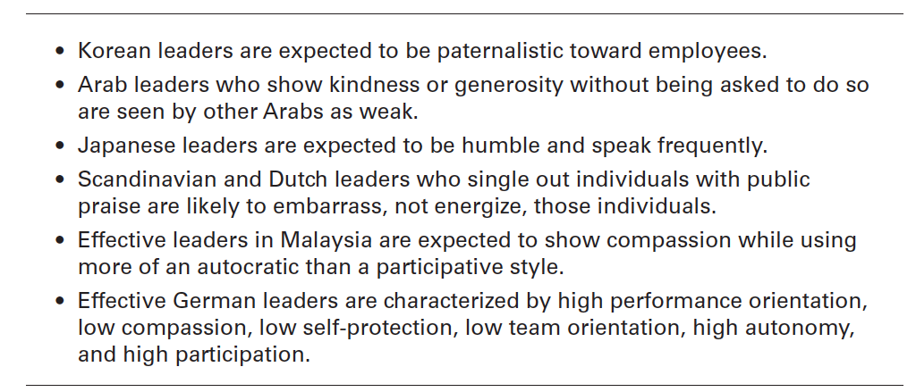
Figura 17-7 liderança em diferentes culturas
17 - 38
Notes:
Exhibit 17-7 provides some findings from selected examples of cross-cultural leadership studies. Because most leadership theories were developed in the United States, they have an American bias.

Slide 43
Tornar-se um líder eficaz
Formação em liderança
  A formação tem mais probabilidade de ser bem sucedida para indivíduos com elevados níveis de automonitorização (self-monitoring).
  Os indivíduos cujos níveis de motivação para a liderança são mais elevados estão mais recetivos a oportunidades de formação e desenvolvimento em liderança.
17 - 39
Notes:
Evidence indicates that leadership training is more likely to be successful with individuals who are high self-monitors than with low self-monitors.
Such individuals have the flexibility to change their behavior as different situations may require. In addition, organizations may find that individuals with higher levels of a trait called motivation to lead are more receptive to leadership development opportunities.

Slide 44


